Slide 1
FreeBies For NewBies
Android Application

Slide 2
Freebies for Newbies
Project Description:
This app helps International Students to register themselves as users to update new events and get access to all the events(cultural, sports and food) that are free of cost and also helps users to find free items in their locality. find nearby free items.
Mentor & Client:
Dr. Chandra Mouli Kotteti

Slide 3
Team Members
Jaichand Mulakalapalli
(TEAM LEADER) BACKEND
Manoj kumar gude
FRONTEND
Adithya krishna raavi
FRONTEND
Saibabu devarapalli
Fullstack
Harish Chowdary bala
DATABaSE administrator

Slide 4
Why Android?
Wider pool of customers
User friendly
Easier installation
Easier entry to the market
Compatible with more devices
Lower development costs

Slide 5
Android Studio
Android Studio is the official Integrated Development Environment (IDE)
Android studio provides environment to built android apps for mobiles phones, desktops, tablets etc..,
Structured code modules allow you to divide your project into units of functionality that you can independently build, test, and debug.
Android apps can be written using Kotlin, Java, and C++ languages.
Android Application = Code + Resources

Slide 6
Application fundamentals
The Android operating system is a multi-user Linux system in which each app is a different user.
By default, the system assigns each app a unique Linux user ID (the ID is used only by the system and is unknown to the app). The system sets permissions for all the files in an app so that only the user ID assigned to that app can access them.
Each process has its own virtual machine (VM), so an app's code runs in isolation from other apps.
By default, every app runs in its own Linux process. The Android system starts the process when any of the app's components need to be executed, and then shuts down the process when it's no longer needed or when the system must recover memory for other apps.

Slide 7
App Components
App components are the essential building blocks of an Android app. Each component is an entry point through which the system or a user can enter your app. Some components depend on others.
There are four different types of app components:
Activities
Services
Broadcast receivers
Content providers

Slide 8
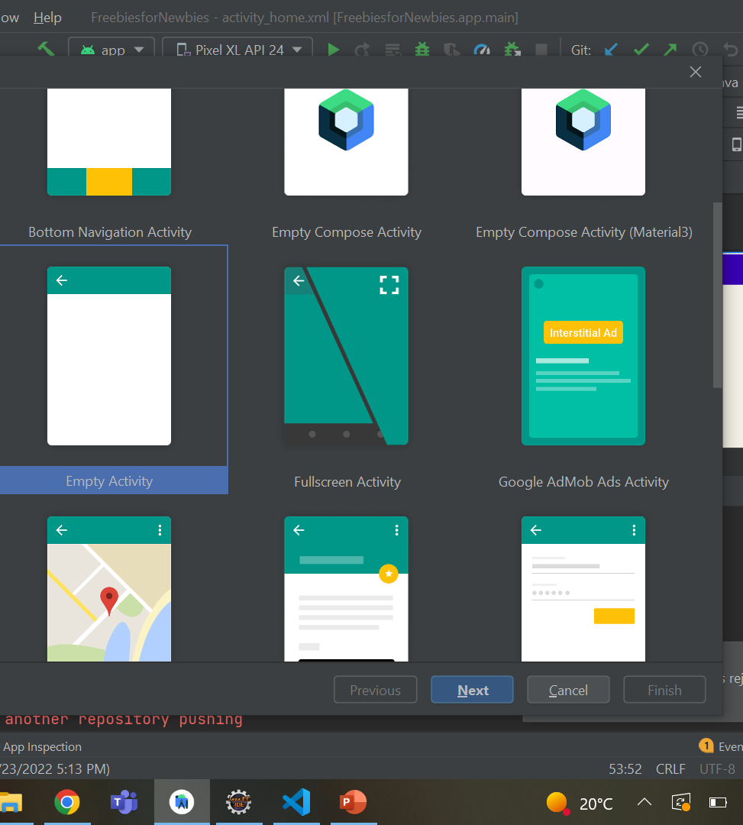
Activity
An activity is the entry point for interacting with the user. It represents a single screen with a user interface.
For example, an email app might have one activity that shows a list of new emails, another activity to compose an email, and another activity for reading emails.
Keeping track of what the user currently cares about (what is on screen) to ensure that the system keeps running the process that is hosting the activity.
Providing a way for apps to implement user flows between each other, and for the system to coordinate these flows.
Fig 1. Predefined Activities

Slide 9
Services
A service is a general-purpose entry point for keeping an app running in the background for all kinds of reasons.
It is a component that runs in the background to perform long-running operations or to perform work for remote processes.
A service does not provide a user interface.
There are two types of services that tell the system how to manage an app: started services and bound services.

Slide 10
Started Services
Started services tell the system to keep them running until their work is completed.
This could be to sync some data in the background or play music even after the user leaves the app.
Syncing data in the background or playing music also represent two different types of started services that modify how the system handles them:
Music playback is something the user is directly aware of, so the app tells the system this by saying it wants to be foreground with a notification to tell the user about it
A regular background service is not something the user is directly aware as running, so the system has more freedom in managing its process.

Slide 11
Bound services
Bound services run because some other app (or the system) has said that it wants to make use of the service.
This is basically the service providing an API to another process.
So, if process A is bound to a service in process B, it knows that it needs to keep process B (and its service) running for A
Further, if process A is something the user cares about, then it also knows to treat process B as something the user also cares about.
Service is implemented as a subclass of service

Slide 12
Broadcast Receivers
A broadcast receiver is a component that enables the system to deliver events to the app outside of a regular user flow, allowing the app to respond to system-wide broadcast announcements.
Because broadcast receivers are another well-defined entry into the app, the system can deliver broadcasts even to apps that aren't currently running.
For example, an app can schedule an alarm to post a notification to tell the user about an upcoming event... and by delivering that alarm to a BroadcastReceiver of the app, there is no need for the app to remain running until the alarm goes off.

Slide 13
Content Providers
A content provider manages a shared set of app data that you can store in the file system, in a SQLite database, on the web, or on any other persistent storage location that your app can access.
Through the content provider, other apps can query or modify the data if the content provider allows it.

